Slide 1
Collision Detection
David Johnson
Cs6360 – Virtual Reality

Slide 2
Basic Problems
Too many objects
Discrete Sampling
Complex Objects

Slide 3
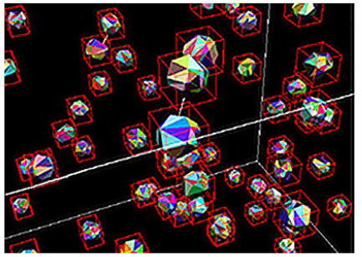
Too Many Objects
Even if cheap to detect collisions, will have n^2 checks
http://www.youtube.com/watch?v=OBzBfhrjx5s&feature=related

Slide 4
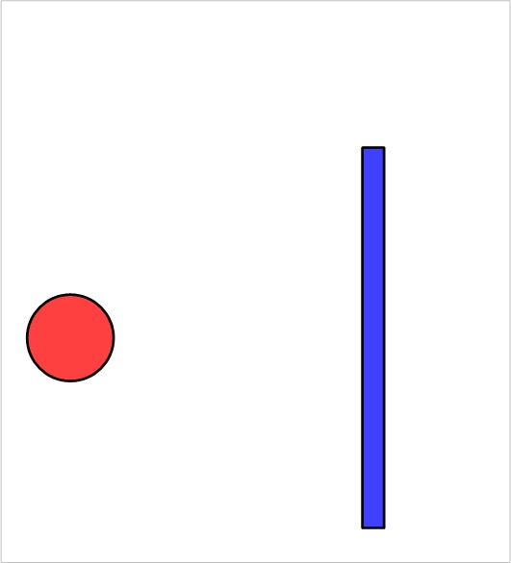
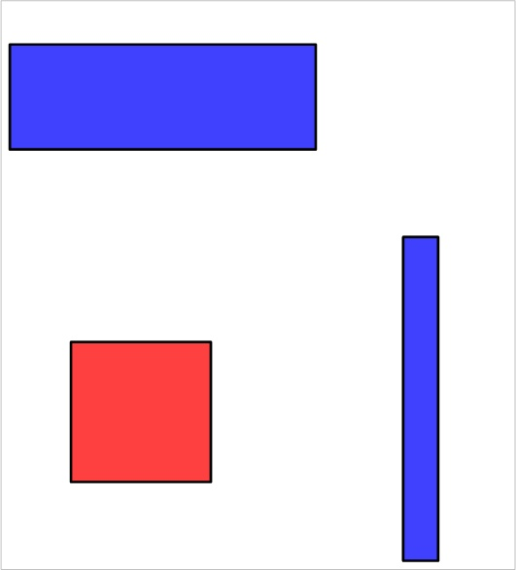
Tunneling

Slide 5
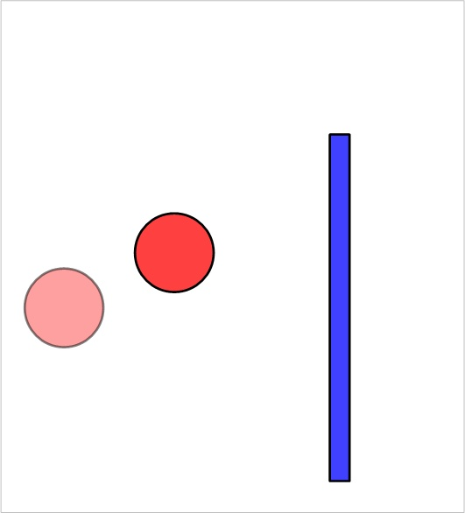
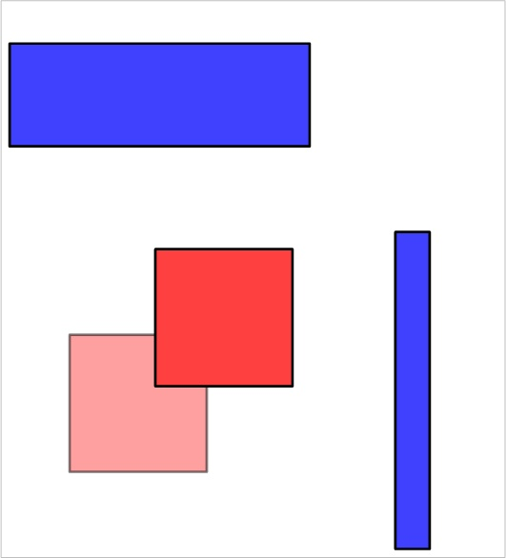
Tunneling

Slide 6
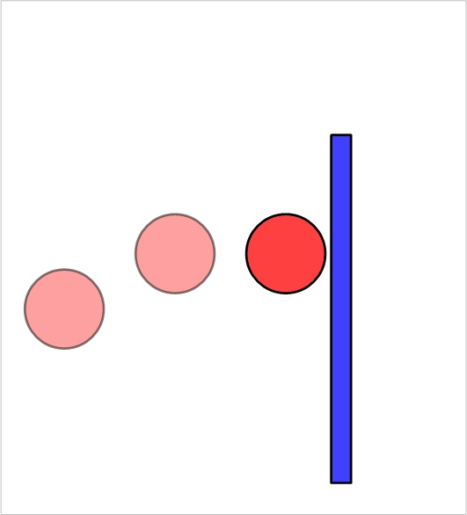
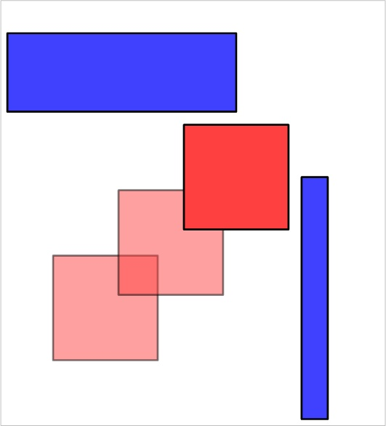
Tunneling

Slide 7
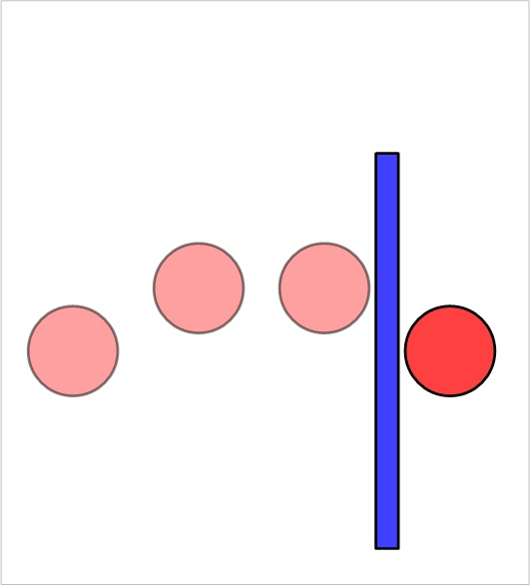
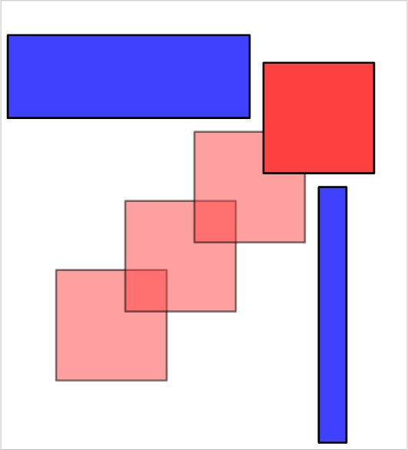
Tunneling

Slide 8
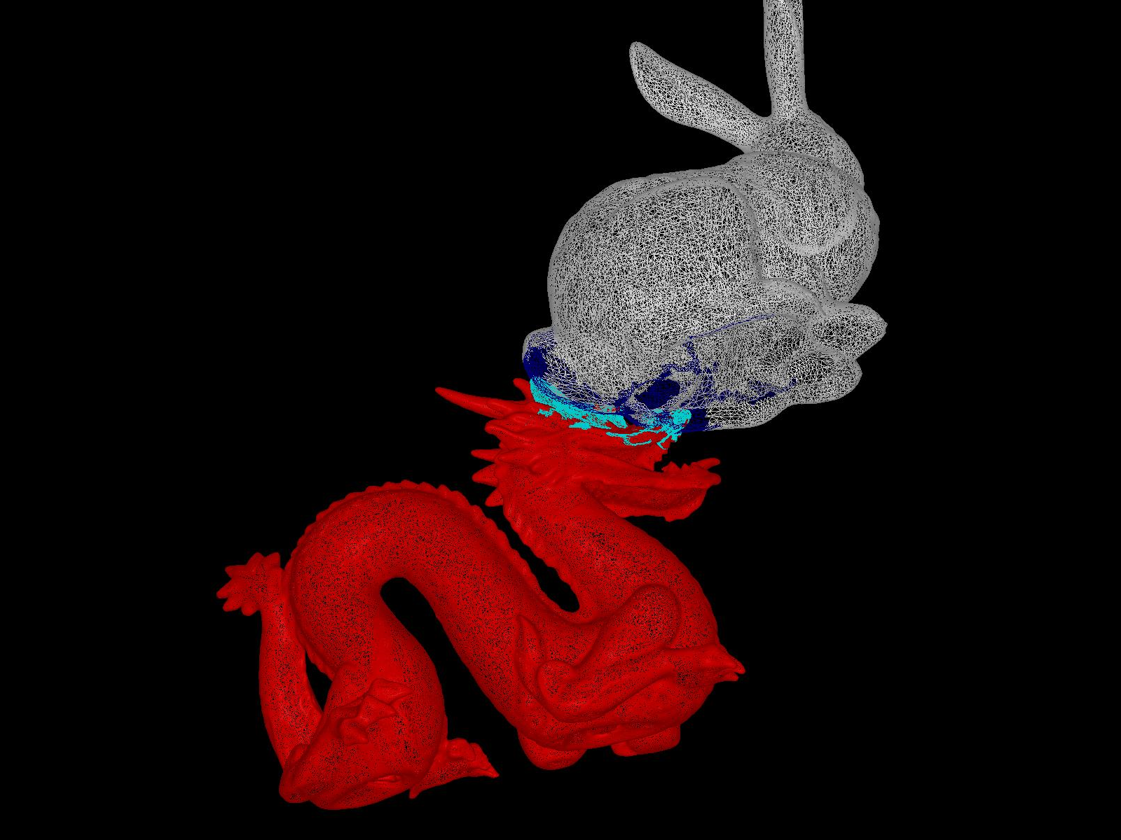
Complex Objects
N^2 problem between triangles of individual models

Slide 9
Approaches
Too many objects
  Partition Space
  Velocity Bounds

Slide 10
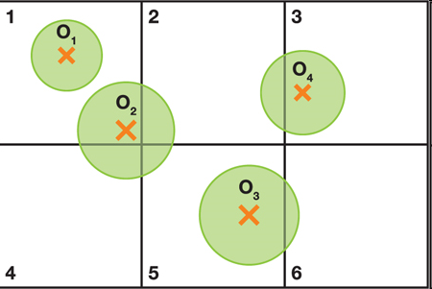
Spatial Partition
Uniform Grid

Slide 11
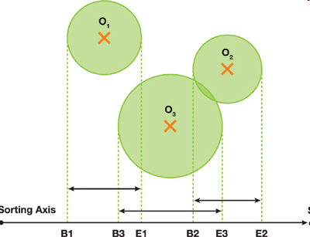
Interval Projection
Project bounding volume on each axis
  Maintain sorted lists
  Possible collision when intervals overlap

Slide 12
Tunneling
Fundamentally a sampling problem
  If you know the max velocity and minimum thickness, can bound the error

Slide 13
Tunneling
Fundamentally a sampling problem
  If you know the max velocity and minimum thickness, can bound the error

Slide 14
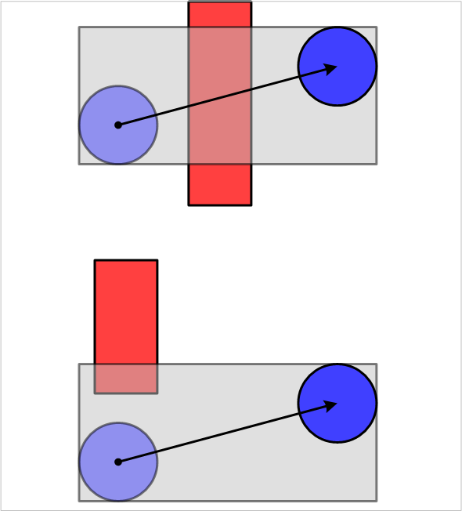
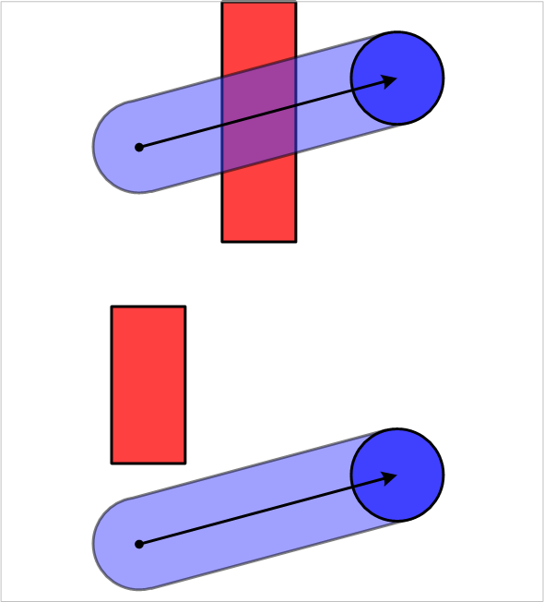
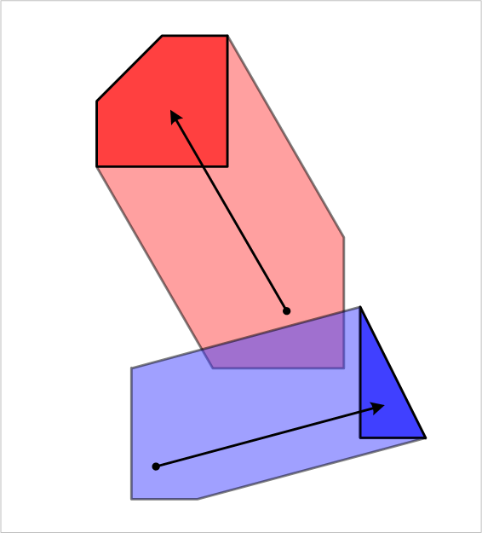
Sweep Methods
Sweep out the volume along the path
  Different accuracy choices
Test for collisions
  False positives
  Bisect the interval
Rotations are tough

Slide 15
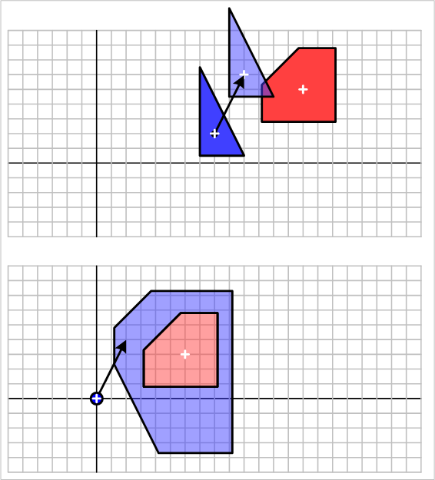
Time of collision
Interval Halving
Conservative Advancement
Minkowski Difference/ray-cast

Slide 16
Collision for Complex Models
Models may have millions of primitives
  Not moving independently, so sweep methods are overkill
  Spatial partitions are tough to update
  May be in close proximity for extended periods
    Need to avoid false positives

Slide 17
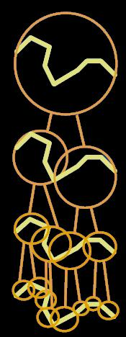
Bounding Volumes
Objects are often not colliding
  Need fast reject for this case
  Surround with some bounding object
    Like a sphere
Why stop with one layer of rejection testing?
  Build a bounding volume hierarchy (BVH)
    A tree

Slide 18
Bounding Volume Hierarchies
Model Hierarchy:
  each node has a simple volume that bounds a set of triangles
  children contain volumes that each bound a different portion of the parent’s triangles
  The leaves of the hierarchy usually contain individual triangles
A binary bounding volume hierarchy:

Slide 19
BVH-Based Collision Detection

Slide 20
Type of Bounding Volumes
Spheres
Ellipsoids
Axis-Aligned Bounding Boxes (AABB)
Oriented Bounding Boxes (OBBs)
Convex Hulls
k-Discrete Orientation Polytopes (k-dop)
Spherical Shells
Swept-Sphere Volumes (SSVs)
  Point Swept Spheres (PSS)
  Line Swept Spheres (LSS)
  Rectangle Swept Spheres (RSS)
  Triangle Swept Spheres (TSS)

Slide 21
BV Choices
OBB or AABB
  OBB slightly better for close proximity
  AABB better for handling deformations

Slide 22
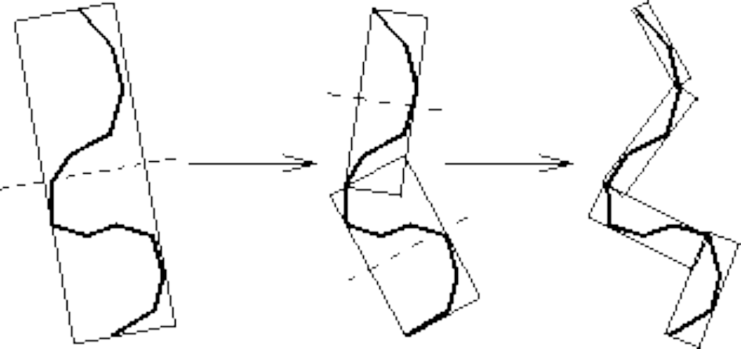
Building an OBBTree
Recursive top-down construction:
partition and refit

Slide 23
Building an OBB Tree
Given some polygons,
consider their vertices...

Slide 24
Building an OBB Tree
… and an arbitrary line

Slide 25
Building an OBB Tree
Project onto the line
Consider variance of
distribution on the line

Slide 26
Building an OBB Tree
Different line,
different variance

Slide 27
Building an OBB Tree
Maximum Variance

Slide 28
Building an OBB Tree
Minimal Variance

Slide 29
Building an OBB Tree
Given by eigenvectors
of covariance matrix
of coordinates
of original points

Slide 30
Building an OBB Tree
Choose bounding box
oriented this way

Slide 31
Building an OBB Tree
Good Box

Slide 32
Building an OBB Tree
Add points:
worse Box

Slide 33
Building an OBB Tree
More points:
terrible box

Slide 34
Building an OBB Tree
Compute with extremal points only

Slide 35
Building an OBB Tree
“Even” distribution:
good box

Slide 36
Building an OBB Tree
“Uneven” distribution:
bad box

Slide 37
Building an OBB Tree
Fix: Compute facets of convex hull...

Slide 38
Building an OBB Tree
Better: Integrate over facets

Slide 39
Building an OBB Tree
… and sample them uniformly

Slide 40
Tree Traversal
Disjoint bounding volumes:
No possible collision

Slide 41
Tree Traversal
Overlapping bounding volumes:
  split one box into children
  test children against other box

Slide 42
Tree Traversal

Slide 43
Tree Traversal
Hierarchy of tests

Slide 44
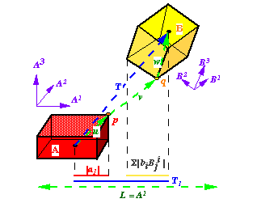
Separating Axis Theorem
L is a separating axis for OBBs A & B, since A & B become disjoint intervals under projection onto L

Slide 45
Separating Axis Theorem
Two polytopes A and B are disjoint iff there
exists a separating axis which is:
perpendicular to a face from either
or
perpendicular to an edge from each

Slide 46
Implications of Theorem
Given two generic polytopes, each with E edges and F faces, number of candidate axes to test is:
2F + E²
OBBs have only E = 3 distinct edge directions, and only F = 3 distinct face normals. OBBs need at most 15 axis tests.
Because edge directions and normals each form orthogonal frames, the axis tests are rather simple.

Slide 47
OBB Overlap Test: An Axis Test
L
s
h
a
h
b
L is a separating axis iff:
s
>
h
+
h
a
b

Slide 48
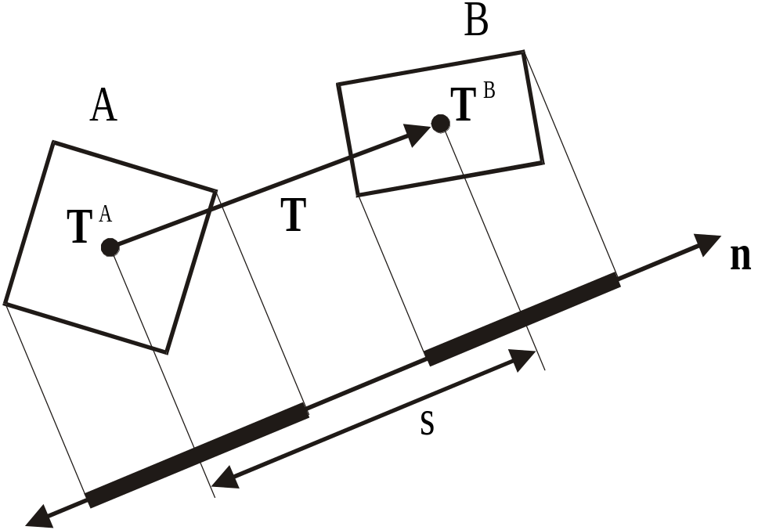
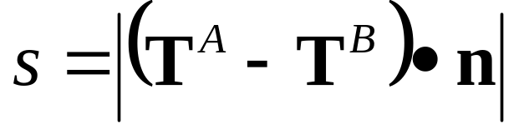
OBB Overlap Test: Axis Test Details
Box centers project to interval midpoints, so
midpoint separation is length of vector T’s image.

Slide 49
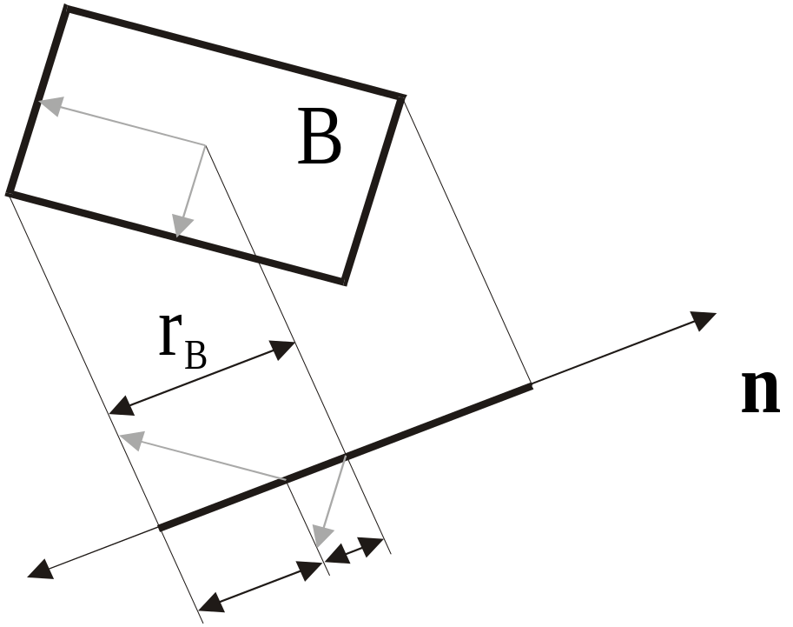
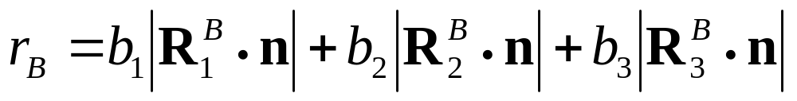
OBB Overlap Test: Axis Test Details
Half-length of interval is sum of box axis images.

Slide 50
OBB Overlap Test
Strengths of this overlap test:
  89 to 252 arithmetic operations per box overlap test
  Simple guard against arithmetic error
  No special cases for parallel/coincident faces, edges, or vertices
  No special cases for degenerate boxes
  No conditioning problems
  Good candidate for micro-coding

Slide 51
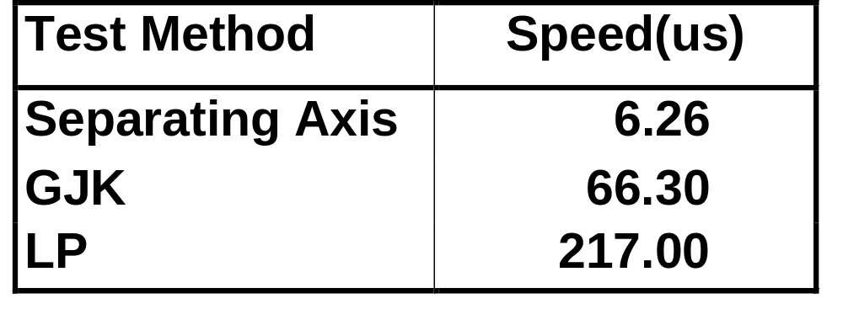
OBB Overlap Tests: Comparison
Benchmarks performed on SGI Max Impact,
250 MHz MIPS R4400 CPU, MIPS R4000 FPU

Slide 52
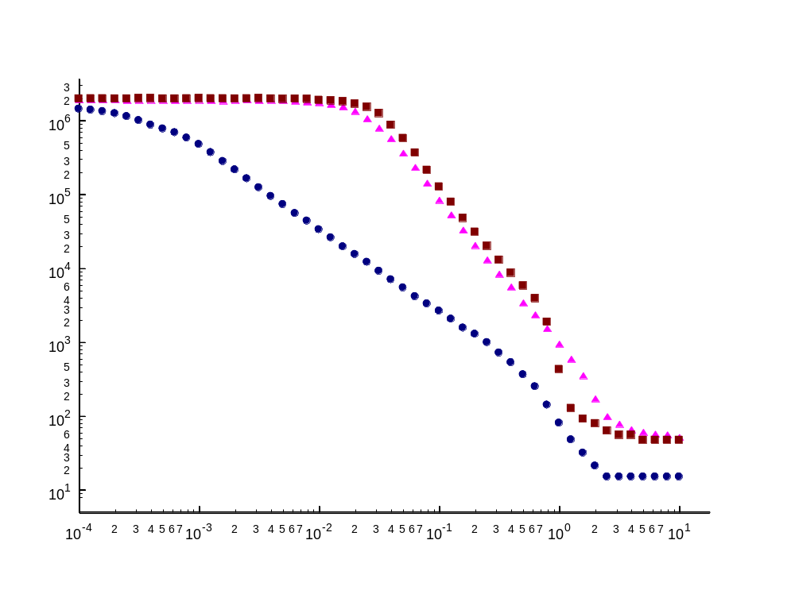
OBBs asymptotically outperform AABBs and spheres
Parallel Close Proximity: Experiment
Log-log plot
Number of BV tests
Gap Size (ε)
Notes:
We verify this in the plot of BV tests versus gap size. This log-log plot shows gap size for concentric spheres on the x-axis, and number of BV tests for that configuration -- the experiment was repeated for each BV type. For extremely large gap sizes, on the right, we have a unit size sphere model inside a very large sphere model -- and there is some minimum number of BV tests required to determine non contact. Then, as we reduce the gap size, we start seeing an increase in the number of BV tests needed -- but the rate of increase of the AABB and sphere tests is greater than the rate of increase of the OBB tests. In fact, the slopes are different -- the AABB and sphere slopes are approximately twice that of the OBB slope. On a log-log plot, only monomial functions are straight lines, and the slope is the degree of the monomial. This means the slope -2 of the AABBs and sphere indicates v = O(1/e^2) and the -2 slope for OBBs means v = O(1/e). So indeed, the former is the square of the latter.

Slide 53
Implementation: RAPID
Available at: http://www.cs.unc.edu/~geom/OBB
Part of V-COLLIDE: http://www.cs.unc.edu/~geom/V_COLLIDE
Thousands of users have ftp’ed the code
Used for virtual prototyping, dynamic simulation, robotics & computer animation

